Slide 1
Central Monitoring System
Nitol Motors Ltd

Slide 2
Central Monitoring System(CMS)
CMS
Site URL
Local Address : http://172.16.3.98/cms
Real Address: http://115.69.211.54/cms
CMS - CSD
CMS - SPD
Site URL
Local Address : http://172.16.3.98/cmscsd
Real Address: http://115.69.211.54/cmscsd
Site URL
Local Address : http://172.16.3.98/cmscsd
Real Address: http://115.69.211.54/cmsspd

Slide 3
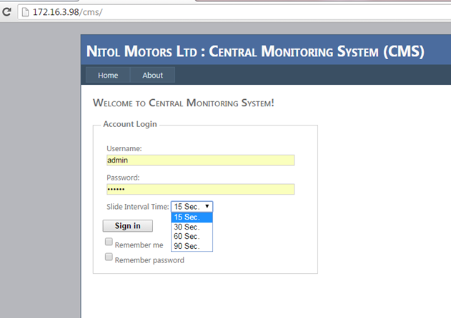
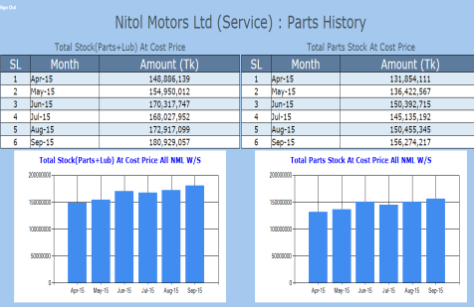
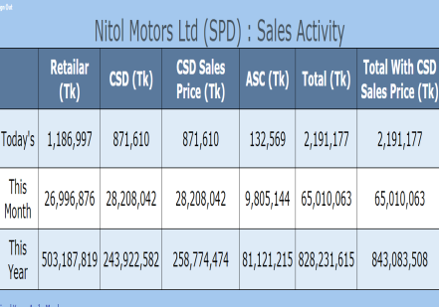
Central Monitoring System(CMS)
Authentication Login
Username : admin
Password : 123456
Set report interval/duration time during login time
15 Sec.

Slide 4
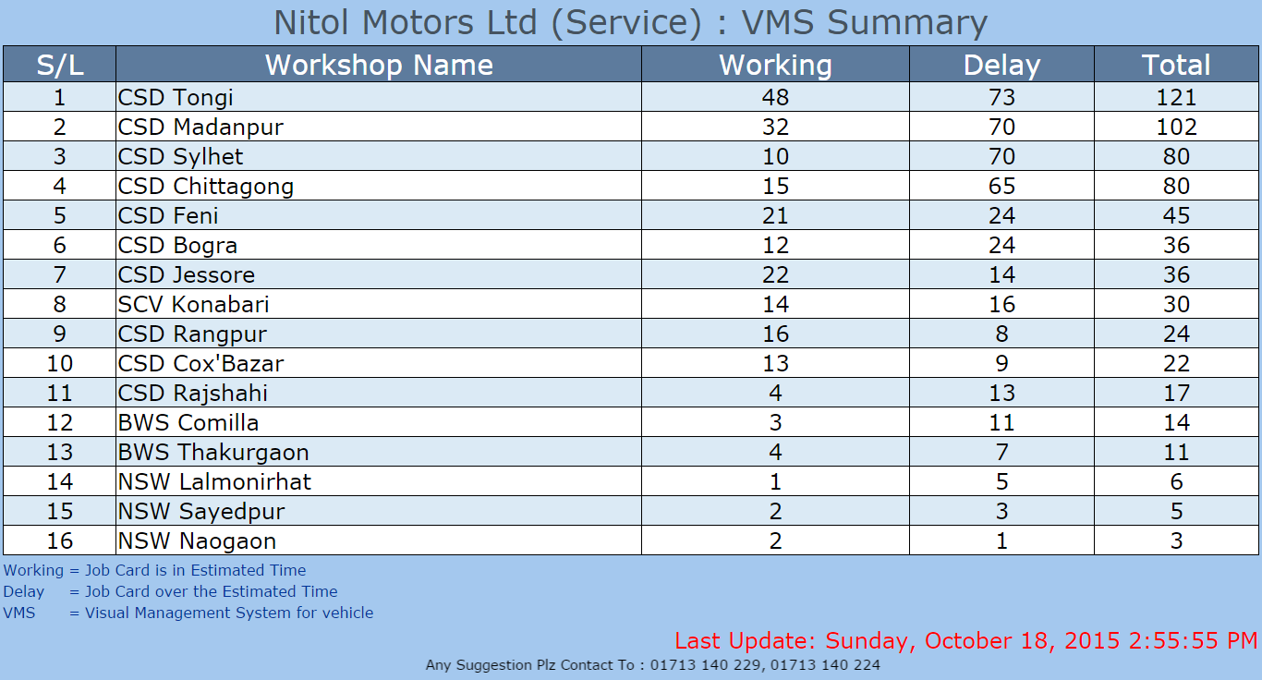
Central Monitoring System(CMS)

Slide 5
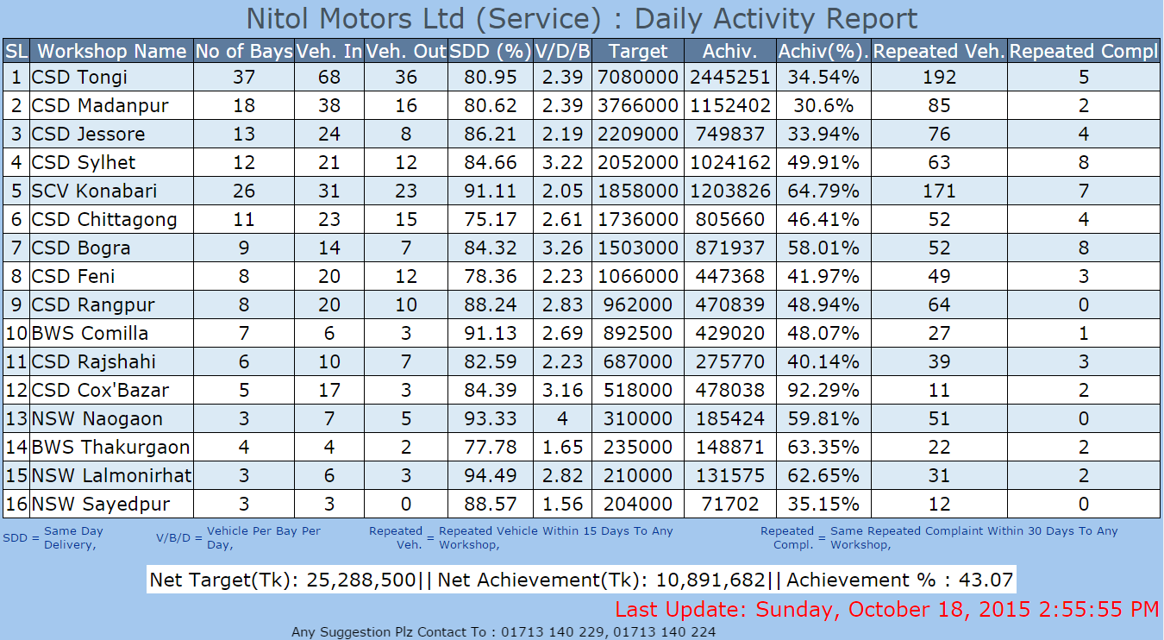
Central Monitoring System(CMS)

Slide 6
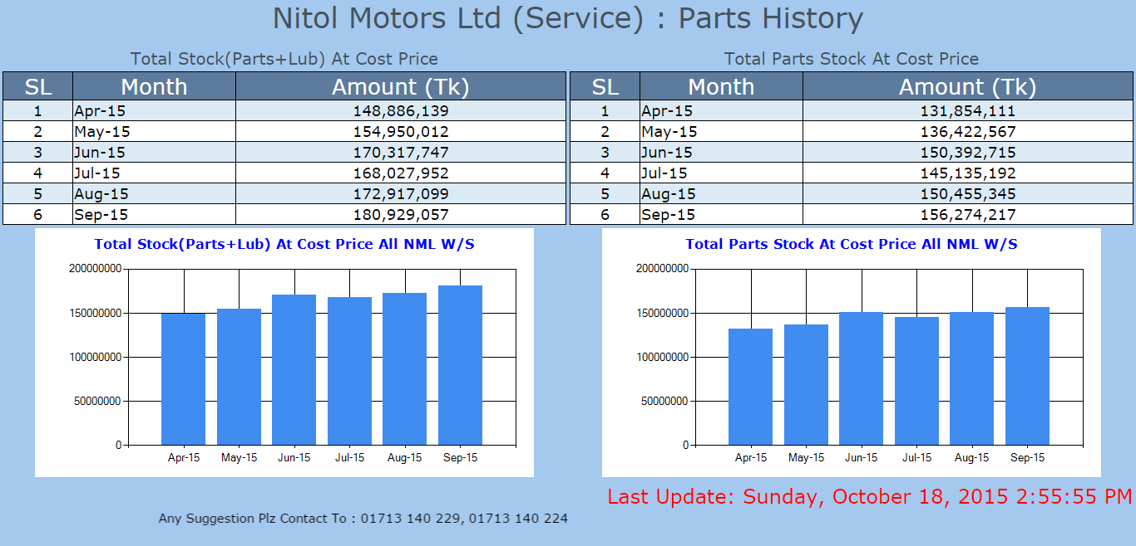
Central Monitoring System(CMS)

Slide 7
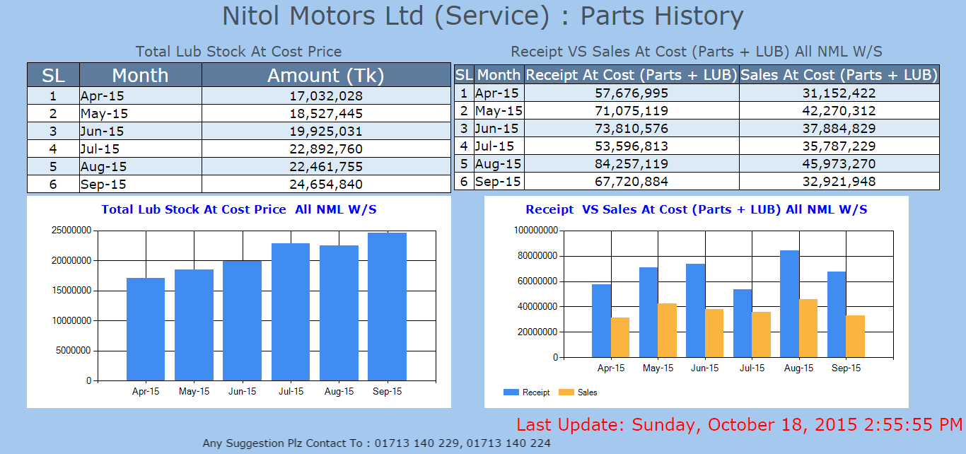
Central Monitoring System(CMS)

Slide 8
Central Monitoring System(CMS)

Slide 9
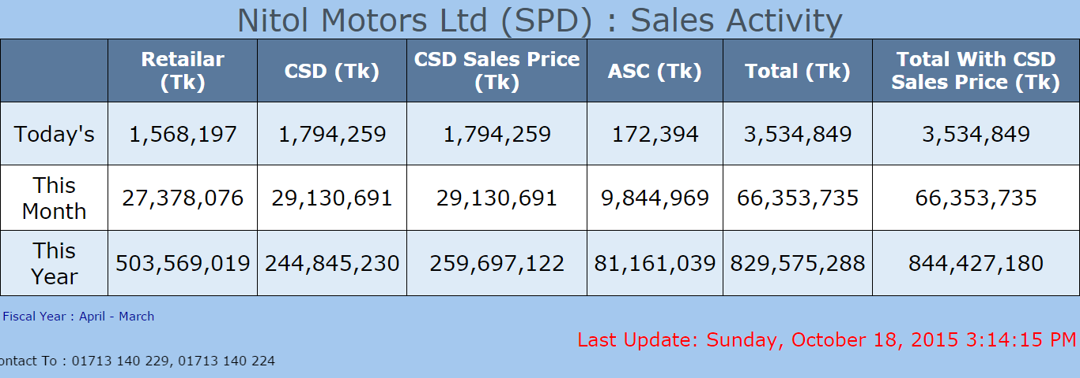
Central Monitoring System(CMS)

Slide 10
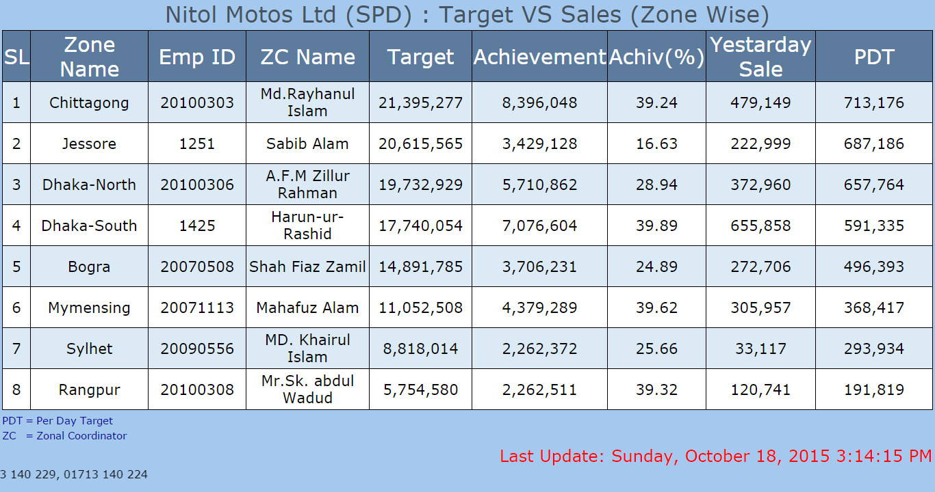
Central Monitoring System(CMS)

Slide 11
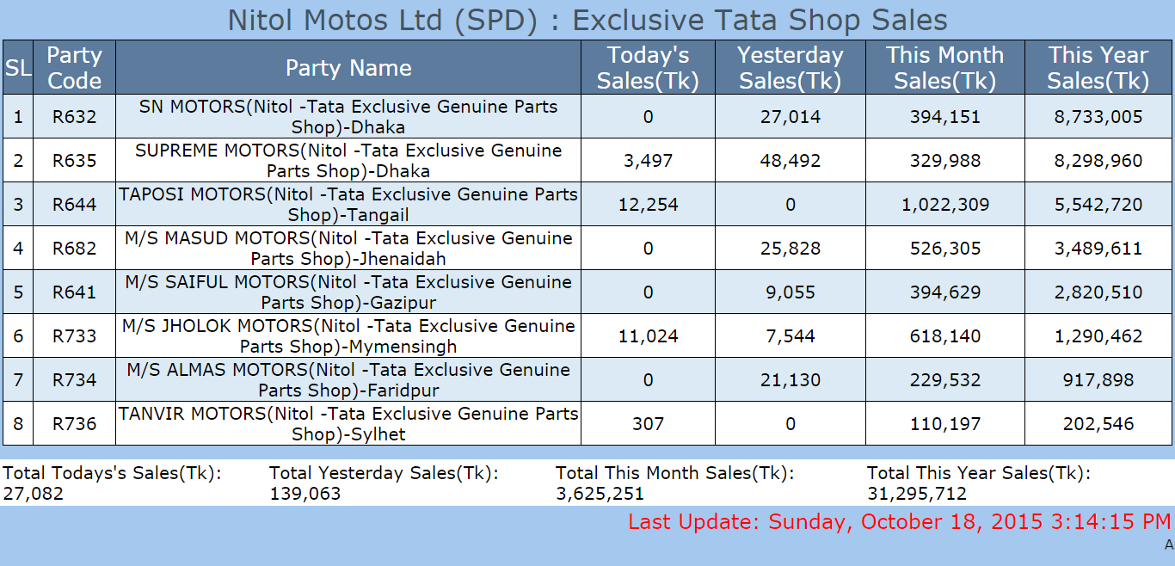
Central Monitoring System(CMS)

Slide 12
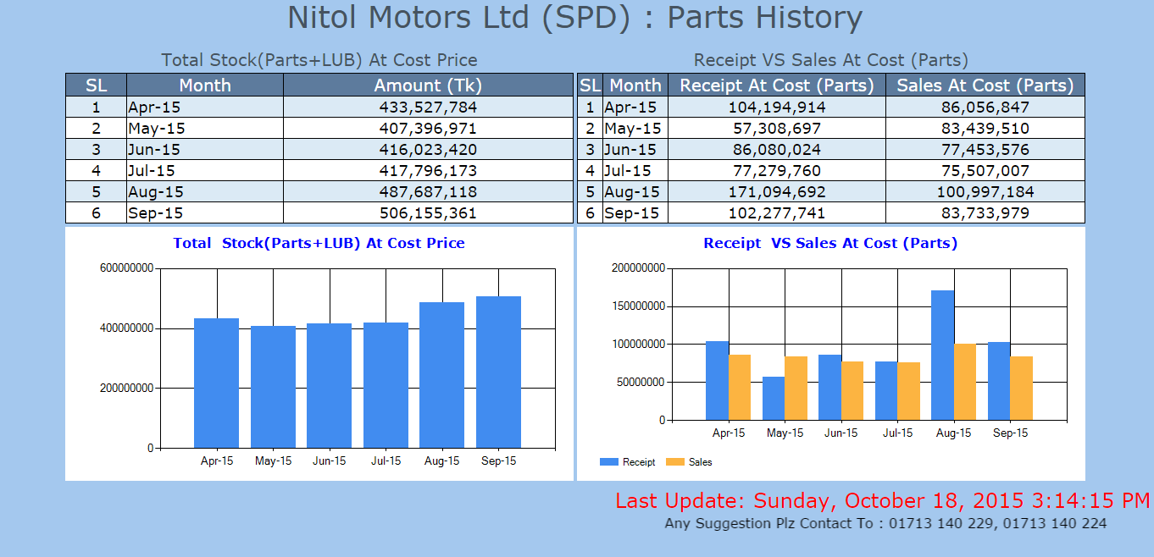
Central Monitoring System(CMS)

Slide 13
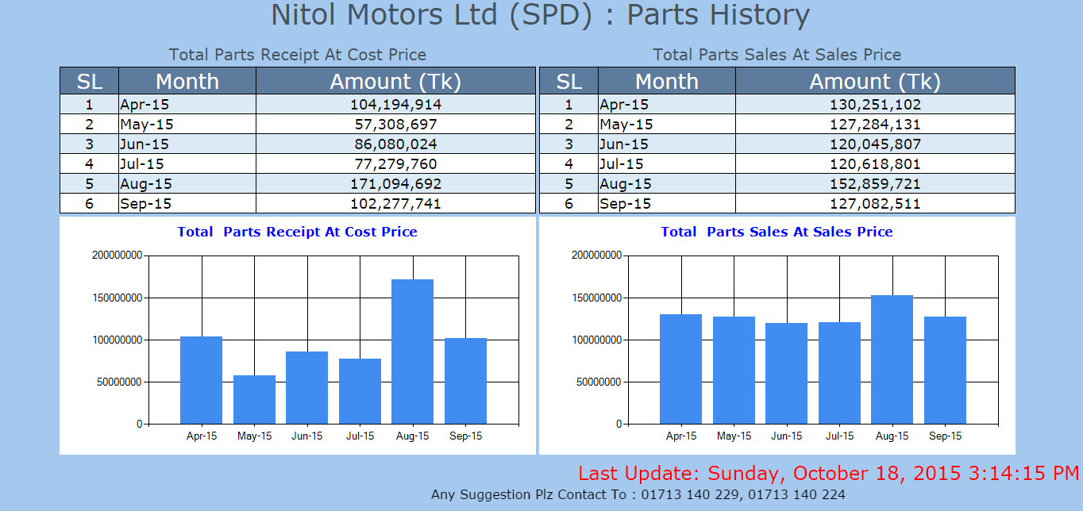
Central Monitoring System(CMS)

Slide 14
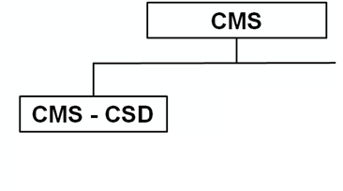
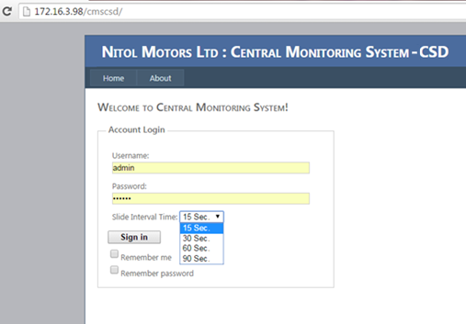
Central Monitoring System - CSD
Site URL
Local Address : http://172.16.3.98/cmscsd
Real Address: http://115.69.211.54/cmscsd
Authentication Login
Username : admin
Password : 123456
Set report interval/duration time during login time
15 Sec.

Slide 15
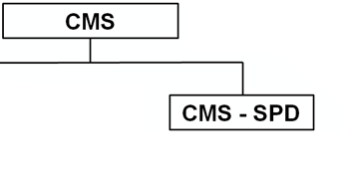
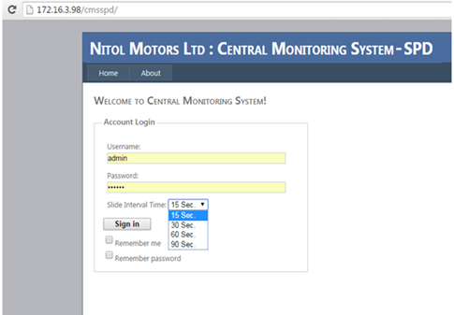
Central Monitoring System - SPD
Site URL
Local Address : http://172.16.3.98/cmscsd
Real Address: http://115.69.211.54/cmsspd
Authentication Login
Username : admin
Password : 123456
Set report interval/duration time during login time
15 Sec.

Slide 16
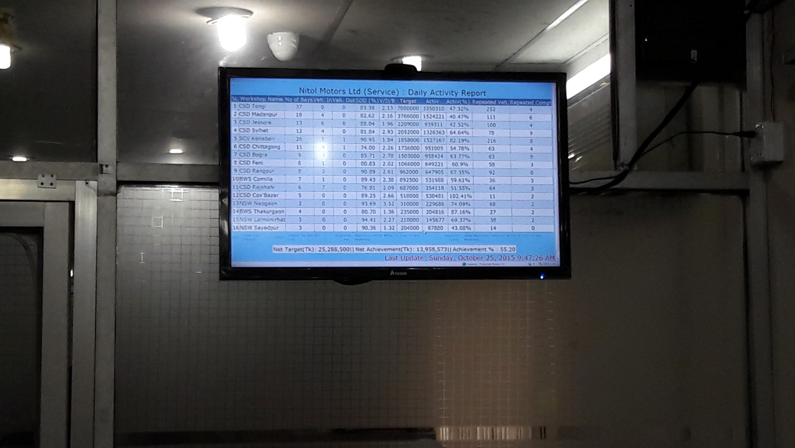
Central Monitoring System(SPD)
Sample Image : Monitoring from C.B.O room

Slide 17
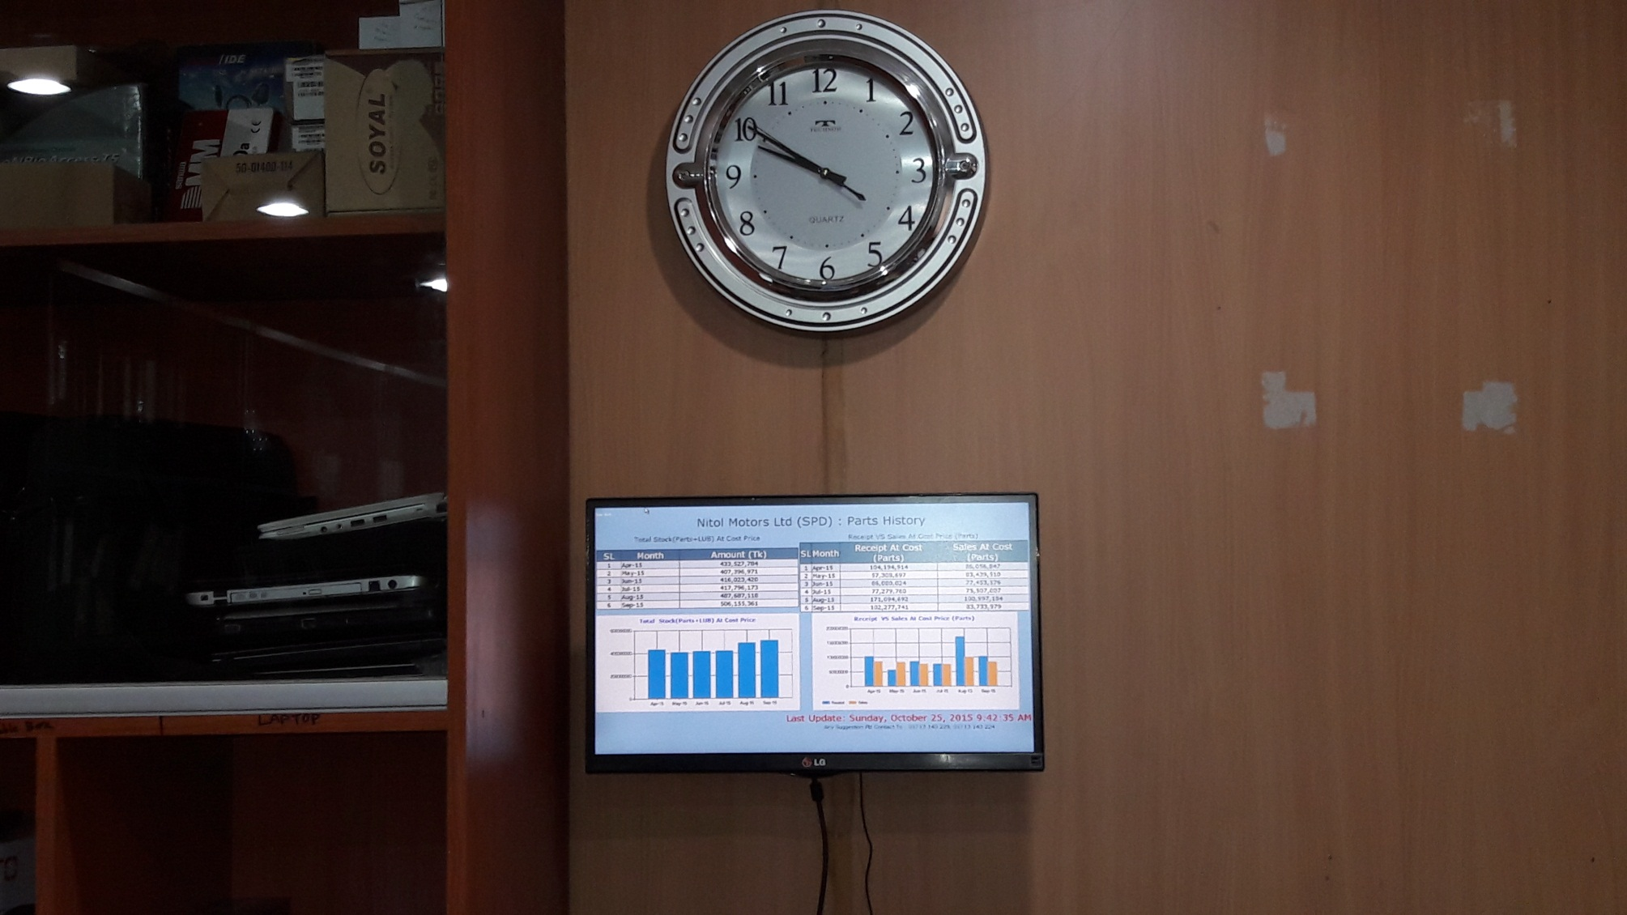
Central Monitoring System(SPD)
Sample Image : Monitoring from IT dept

Slide 18
Central Monitoring System(CMS)
For any query/suggestion/feedback feel free to contact to 01713 140 229 or 01713 140 222
Nitol Motors Ltd (Service & Parts)
Dept Of Information Technology
Thank You

